Slide 1
Spokane Reference Site Layout
Urbanova | Smart Cities

Slide 2
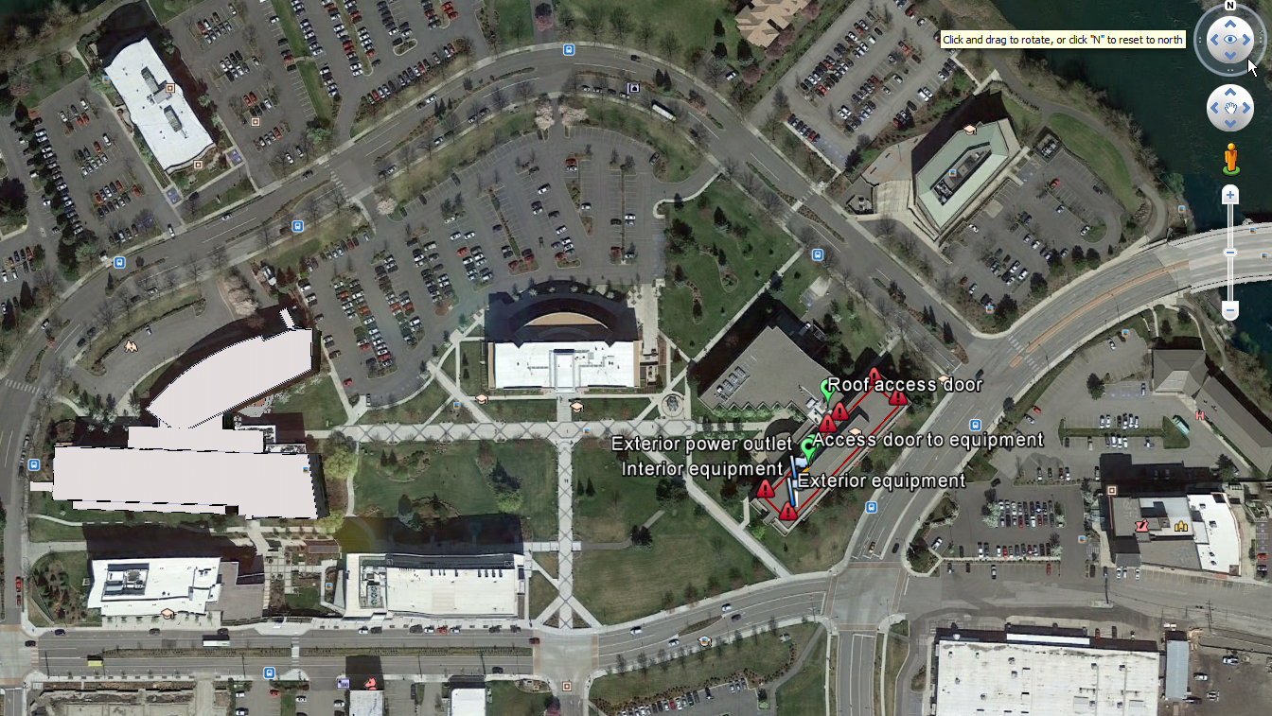
Orientation view: WSU Spokane campus

Slide 3
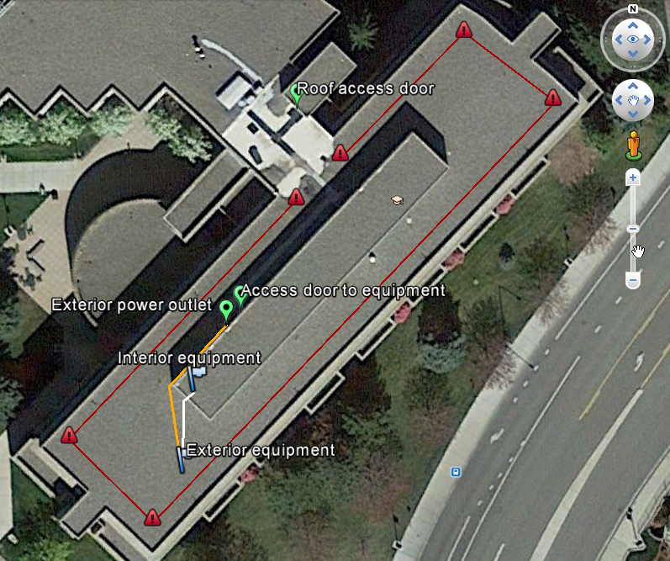
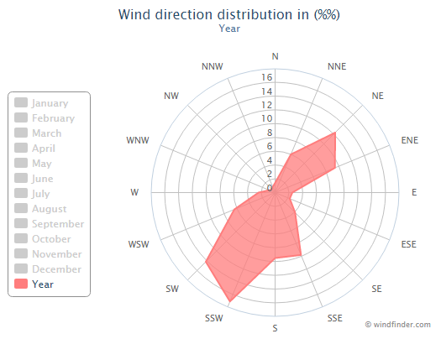
Site Layout
Sampling location potentially impaired by penthouse

Slide 4
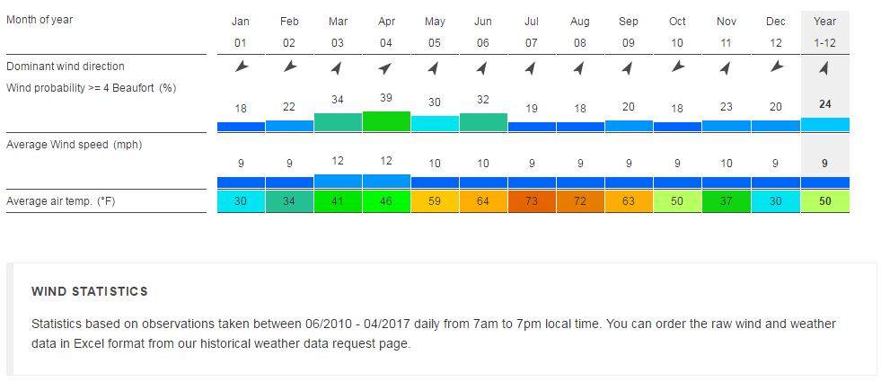
Data for Spokane Airport

Slide 5
?s
Continue without changes?
Data was for airport, which may not represent downtown
Data was constrained to daytimes (7a-7p)
Revisit location on current rooftop?
Put equipment on penthouse?
Not if restricted to ladder access (probably the case)

